Slide 2

Predicting 10-Year Cardiovascular Events using Machine Learning & Deep Learning: Heart Attack or Stroke Model
GitHub-Repository:
https://github.com/akampa-776/Predicting-10-year-Cardiovascular-Event-using-Machine-Learning-Heart-attack-or-Stroke-Model
By Group One:
Nazziwa Rhoda
Nameeru Bronah
Akampa Godfrey
This project uses machine learning to support earlier identification of people at risk for cardiovascular complications.

Slide 3
Our Respiratory Structure-Model
Summary of best model performance
Recommendations & Future work
Contribution: ALL MEMBERS
Understand features with a high level initial examination.
Contribution: Rhoda Nazziwa
A. Exploratory Data Analysis (EDA)
B. Classical Machine Learning
C. Deep Learning Approach
D. Model Deployment
E. Conclusions & Recommendations
Best-performing model to be saved via stream-lit to a Live web app for clients
Contribution: ALL MEMBERS
Build and compared classification models Contribution: Nameeru Bronah
Neural network model (fully connected feed-forward) Contribution: AKAMPA GODFREY

Slide 4

Project Background
Context:
Cardiovascular diseases (CVDs) remain the leading cause of mortality globally, responsible for over 19.8 million deaths (85%) were due to heart attack and stroke (WHO, 2024).
Problem Statement and Justification:
The greatest burden is in low- and middle- income countries such as Uganda with where CVDs contribute to approximately 10% of premature deaths (ages 30-70 years) (Okello, E., 2020) .
Motivation:
Existing risk scores (Traditional tools) such as Framingham, QRISK struggle with complex clinical interactions between lifestyle, clinical and demographic factors.
Notes:
World Health Organization. (2024, June 11). Cardiovascular diseases (CVDs) [Fact sheet]. https://www.who.int/news-room/fact-sheets/detail/cardiovascular-diseases-(cvds)
Okello, E., Omagino, J., Fourie, J. M., Scholtz, W., Nel, G., Scarlatescu, O., & Lwabi, P. (2020). Uganda country report. Cardiovascular Journal of Africa, 31(4 Suppl 1), S42–S48. https://doi.org/10.5830/CVJA-2020-037

Slide 5

Goal and Objectives
Project Goal: Develop a Machine Learning-based predictive model capable to enhance 10-year cardiovascular risk prediction, timely preventive care and support data-informed clinical decision-making.
Project specific objectives aim to:
Predict whether a person will experience a heart attack or stroke within the next 10 years.
To identify the most relevant demographic, clinical, and lifestyle predictors associated with 10-year cardiovascular risk.
To develop and evaluate classical ML models (Logistic Regression, Random Forest, KNN) for CVD risk prediction.
To design and train a neural network capable of capturing complex, non-linear risk patterns.

Slide 6

Data Description
Type of Machine Learning
Supervised learning-Binary Classification
Target (y):
heart_attack_or_stroke_occurred (0 = No, 1 = Yes)
Features (X):
Identifier, Demographic, Anthropometric, clinical, Lifestyle Risk Factor, Clinical Measurements, Family History, Follow-up and comorbidity variables (N=15), 100,000 patient records .
Dataset Source:
This was obtained from https://zenodo.org/records/12567416, developed under the NIHR ARC Wessex and the National Centre for Research Methods (NCRM) initiatives
Why a Binary Classification?
It reflects a clear clinical outcome and allows the model to distinguish whether or not a person will experience a heart attack or stroke within the next 10 years.

Slide 7
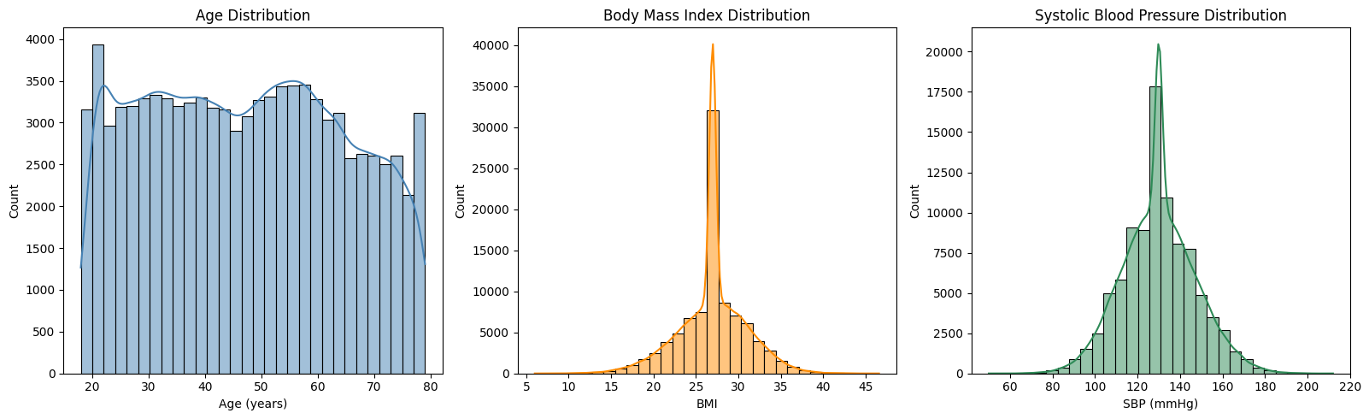
A: Exploratory Data Analysis- EDA
Data Quality and Target Distribution
Univariate Analysis
Table 1: Descriptive Summary-Numeric Features
Figure 1: Descriptive Summary-Numeric Features
Issue | Finding | Action Taken
Duplicate rows | 7,084 duplicate records found | Removed (7,084 rows deleted)
Missing values | body_mass_index 23,289 (25.06%) | Imputed with mean (Normally distributed)
 | systolic_blood_pressure 8,444 (9.09%) | Imputed with mean (normally distributed)
 | forced_expiratory_volume_1 62,241 (66.99%) | Imputed with median (highly skewed)
Target distribution | heart_attack_or_stroke_occurred | Severe class imbalance
No event | 92.89% | Used SMOTE + Alternative evaluation metrics + Specialized algorithms
Yes event (heart attack/stroke) | 7.11% | (appx. 14:1 negative-to-positive ratio)
Key Insight (Class Imbalance): Due to the 93:7 class imbalance, accuracy alone is misleading. We prioritized on utilizing specialized algorithms, evaluation metrics and resampling techniques (SMOTE) on the minority class (Yes event) to ensure the model reliably identifies high-risk patients: the primary goal of preventive cardiology.
Key Insight (Age): The dataset contains age information for 100,000 participants ranging from 18 to 79 years old (mean = 46.9, SD = 17.0).
The interquartile range suggests that the majority of participants fall within early adulthood to late middle age. The close alignment between the mean and average implies that the age distribution is roughly normal.

Slide 8
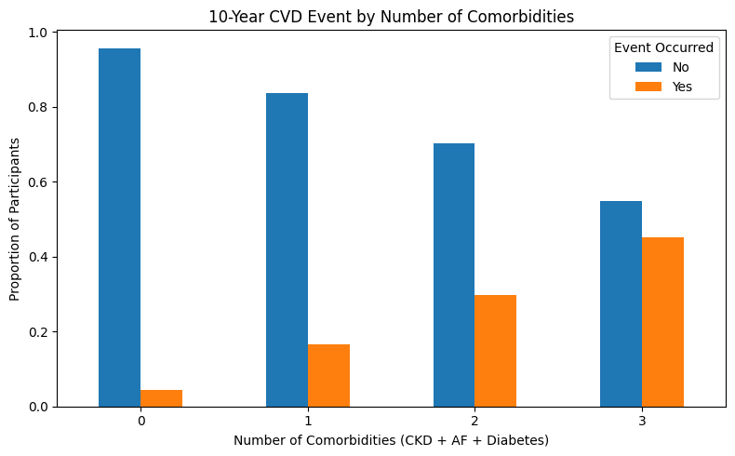
A: Exploratory Data Analysis- EDA
Bivariate Analysis
Multivariate
Table 2: Statistical Tests & Clinical Pattern Insights
Figure 2: Statistical Tests & Clinical Pattern Insights
Clinical Question | Test Used | p-value
Is age higher in patients who had an event? | Mann-Whitney U | < 0.00001
Is SBP higher in the event group? | Mann-Whitney U | < 0.00001
Is BMI different between groups? | Mann-Whitney U | < 0.00001
Is risk different between males & females? | Chi-square | < 0.00001
Does smoking increase 10-year risk? | Chi-square | 0.066
Key Uncovers
Age, SBP, BMI vs Event:
The bivariate analysis shows that age, systolic blood pressure (SBP), and body mass index (BMI) all differ significantly between individuals who experienced a cardiovascular event and those who did not.
This implies that Age, systolic blood pressure (SBP), and BMI all show statistically significant differences between event and non-event groups, confirming that these factors play a major role in predicting cardiovascular risk.
Gender vs Event: There is a statistically significant association between gender and 10-year CVD events (χ² = 290.17, p < 0.00001).
Men experience significantly more heart attacks and strokes than women, with an event rate nearly 50% higher.
Smoking vs Event: There is no statistically significant association between smoking status and occurrence of a heart attack or stroke in this dataset.
This Implies that smoking does not appear to influence the likelihood of experiencing a heart attack or stroke based on the statistical test.
Figure 2 reveals a clear dose-response relationship; i.e. as the number of comorbidities increases, the proportion of participants experiencing a CVD event rises sharply and vice versa.
This demonstrates that CVD risk accelerates with multiple chronic conditions, reflecting the cumulative burden of disease.
Thus, this means that patients with multiple comorbidities (CKD, AF, diabetes) are at substantially higher risk, highlighting the importance of integrated care and early intervention
Notes:
A clear dose-response relationship describes a connection where the magnitude of an effect (the response) in an organism or population changes in a predictable, consistent, and often proportional way with changes in the amount of exposure to a substance (the dose).

Slide 9
B: Machine learning Modelling
Training and Approach used
Machine Learning-Results
Models Trained
Logistic Regression
Random Forest
KNN (n=15)
Approach
SMOTE was applied to correct class imbalance
Models evaluated with:
  Precision
  Recall
  F1 Score
  Confusion Matrix (Notebooks)
Steps followed to avoid target and train-test contaminations
  Load & Initial Examination
  Train-Test Split (stratified) (FIRST!)
  Preprocessing Pipeline (Column Transformer)
  Full ImbPipeline (preprocessor + SMOTE + model)
  Model Training & Evaluation
  Final Model Saving
Table 4: Classification Algorithms performance (Hold-out test (N=18,584))
Model | Precision (Yes) | Recall (Yes) | F1 (Yes)
Logistic Regression | 0.18 | 0.80 | 0.29
Random Forest | 0.19 | 0.23 | 0.21
KNN (n=15) | 0.16 | 0.65 | 0.25
Logistic Regression: Captures 80% of the truest events, Raises only 18% False Alarms and it’s balance (F=29%) between catching cases and avoiding false positives
Random Forest: Captures 23% of the truest events, Raises only 19% False Alarms and it’s a balance (F=21%) between catching cases and avoiding false positives
KNN(n=15): Captures 65% of the truest events, Raises only 16% False Alarms and it’s a balance (F=25%) between catching cases and avoiding false positives
Therefore, with Logistic Regression being selected as the best model with a perfect balance that correctly identifies 8 out of 10 patients who will suffer a heart attack or stroke in the next 10 yrs hence an ideal clinical excellency for population-level screening and early risk detection in resource-limited settings like Uganda.

Slide 10
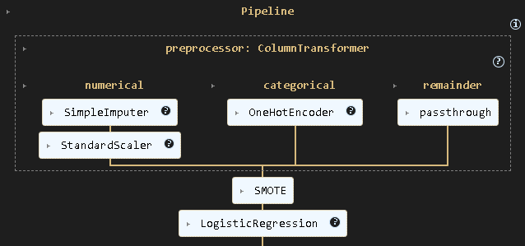
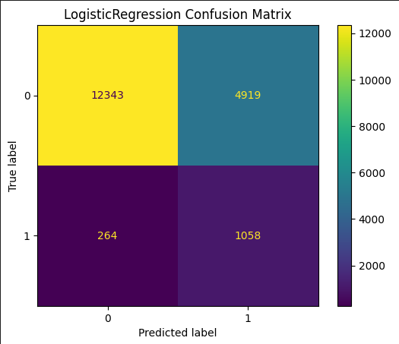
B: Machine learning Modelling
WINNING MODEL- LOGISTIC REGRESSION

Slide 11
C: Deep Learning Approach
Why Deep Learning?
Baseline vs Evidence Based case scenario Comparison
Learns non-linear clinical interactions
Captures relationships classical models may miss
Automatically learns feature combinations
Models Built
Baseline Neural Network
Improved Neural Network
Deep_Learning_cvd_prediction steps taken
Load & Preprocess Data (same as classical)
Train-Test Split
Baseline Neural Network (Simple and quick)
Evaluate Baseline (Get your reference score)
Improved Neural Network (Deeper + Dropout + Callbacks)
Final Evaluation & Comparison
Metric | Baseline NN | Improved NN
Precision (Event) | 0.08 | 0.16
Recall (Event) | 0.78 | 0.78
F1 Score (Event) | 0.14 | 0.26
Accuracy | 0.44 | 73
Recall remained decent (78%), but;
Precision stayed extremely low (0.16 at best) and;
F1-score reached only 0.26 (vs Random Forest 0.91)
Despite extensive tuning (increasing layers, neurons, early stopping, class weighting, focal loss, dropout, etc.), the neural network approach failed to outperform the Logistic Regression model on the critical minority-class metrics.

Slide 12
D: Model Deployment
Deployment Details
Framework: Streamlit (Python)
Live Web Application URL:
Local URL: http://localhost:8501
Network URL: http://192.168.137.169:8501

Slide 13
ANNEXES

Slide 14
Conclusions:
Conclusion
Classical Machine Learning- Logistic Regression performs exceptionally well
The majority of participants fall within early adulthood to late middle age(18-79 yrs).
Age, systolic blood pressure (SBP), and body mass index (BMI) confirm to be factors that play a major role in predicting cardiovascular risk.
Men experience significantly more heart attacks and strokes than women, with an event rate nearly 50% higher.
Smoking does not appear to influence the likelihood of experiencing a heart attack or stroke.
Patients with multiple comorbidities such as clinical Kidney Disease(CKD), Atrial Fibrillation (AF) and diabetes are at substantially higher risk of experiencing a CVD event

Slide 15
Recommendations
Recommendations
Adopt a Logistic Regression as the preferred predictive model for early screening and risk stratification in clinical and public health settings.
Prioritize high-risk groups (older adults, hypertensive individuals, patients with CKD, AF, or diabetes) for targeted prevention programs.
Implement community-based blood pressure and BMI monitoring, given their strong predictive value.
Develop sex-specific prevention strategies to address the disproportionately higher risk among men.
Integrate ML screening tools into routine clinical care, especially in resource-limited settings, to support early detection and reduce long-term CVD burden.

Slide 16
Future Work
Future Work
Deep Learning Expansion: Build and evaluate neural network architectures (MLP, CNN-1D, attention-based models) for improved predictive performance.
Model Deployment: Develop a robust, user-friendly web or mobile application for real-time CVD risk prediction and triage.
Feature Engineering: Explore additional clinical variables (lipid profiles, ECG features, lifestyle metrics) to improve model sensitivity.
Longitudinal Validation: Apply the model to future datasets or real-world cohorts to validate its stability, fairness, and clinical applicability.
Explainability: Integrate SHAP or LIME to enhance model transparency and support clinician trust and decision-making.

Slide 17
Dataset Overview-Data Dictionary Extract
Category | Variable | Description | Data Type | Range / Values
Features (X)/predictors/ independent varibales
Identifier | patient_id | Unique identifier for each patient | String | e.g., PT00085957
Demographic | gender | Biological sex of the patient | String | F, M
 | age | Age in years | Integer | 18–90
Anthropometric | body_mass_index | BMI (weight/height²) | Float | 15.0–50.0
Lifestyle Risk Factor | smoker | Whether the patient is a smoker | Binary | 0 = No, 1 = Yes
Clinical Measurements | systolic_blood_pressure | Systolic blood pressure (mmHg) | Float | 90–200
 | hypertension_treated | Receives treatment for hypertension | Binary | 0 = No, 1 = Yes
 | forced_expiratory_volume_1 | Lung function (FEV1 % predicted) | Float | 20.0–110.0
Family History | family_history_of_cardiovascular_disease | Family history of CVD | Binary | 0 = No, 1 = Yes
Comorbidities | atrial_fibrillation | Presence of atrial fibrillation | Binary | 0 = No, 1 = Yes
 | chronic_kidney_disease | Diagnosis of CKD | Binary | 0 = No, 1 = Yes
 | rheumatoid_arthritis | Diagnosis of rheumatoid arthritis | Binary | 0 = No, 1 = Yes
 | diabetes | Presence of diabetes | Binary | 0 = No, 1 = Yes
 | chronic_obstructive_pulmonary_disorder | COPD status | Binary | 0 = No, 1 = Yes
Follow-up | time_to_event_or_censoring | Follow-up time in years until event or censoring | Integer | 1–10
Target(y)
Outcome Variable | heart_attack_or_stroke_occurred | Heart attack or stroke within follow-up window | Binary | 0 = No, 1 = Yes

